Slide 1
ROBOT PATH PLANNING USING HILBERT SPACE FILLING CURVES

Slide 2
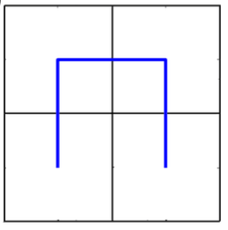
INTRODUCTION​
Goal: Creating a probabilistic roadmap for a mobile robot to navigate from the start configuration to the goal configuration.
Definitions:
Occupancy map – the navigation space of a mobile robot with obstacles and free space.
Free space – subset of occupancy map without obstacles in it.
Viable Path – collision-free path from start configuration Xstart to the goal configuration Xgoal for a mobile robot.
Start
Goal

Slide 3
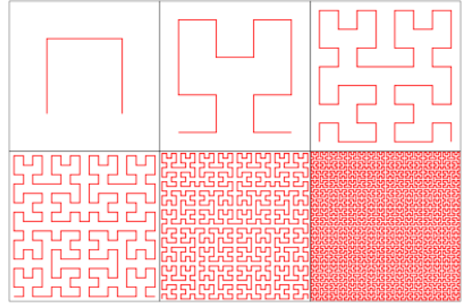
What do Hilbert curves look like?
First to sixth order Hilbert Curves from left to right.

Slide 4

OCCUPANCY MAP EXAMPLE

Slide 5
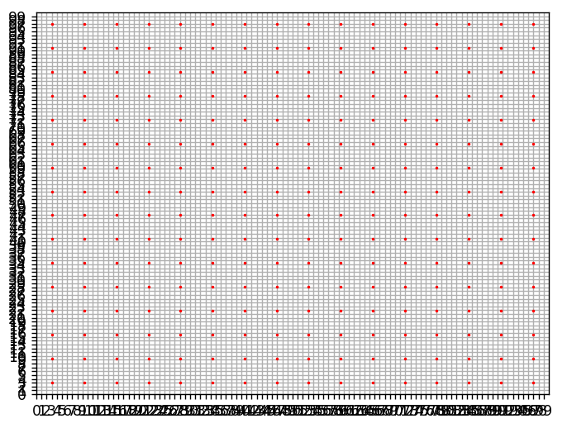
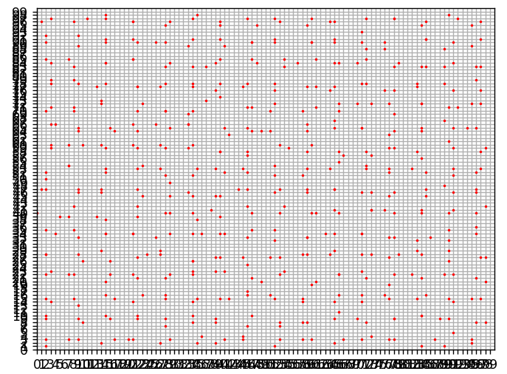
HILBERT CURVE EXAMPLEs
Order 4 Hilbert Curve Deterministic
Order 4 Hilbert Curve Randomized Vertices

Slide 6
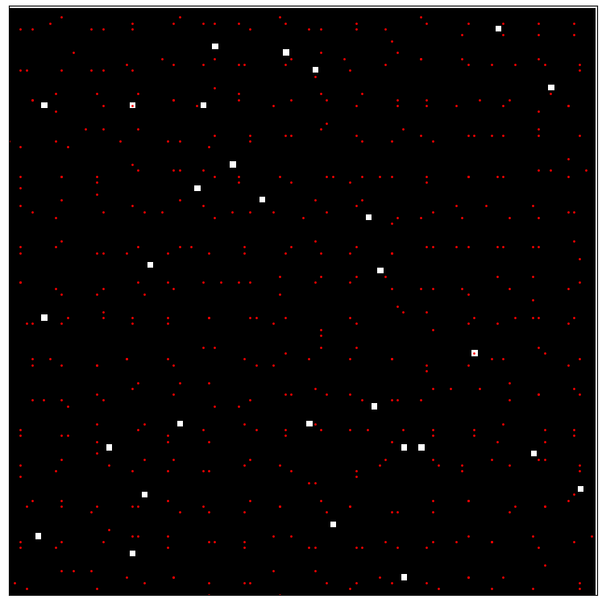
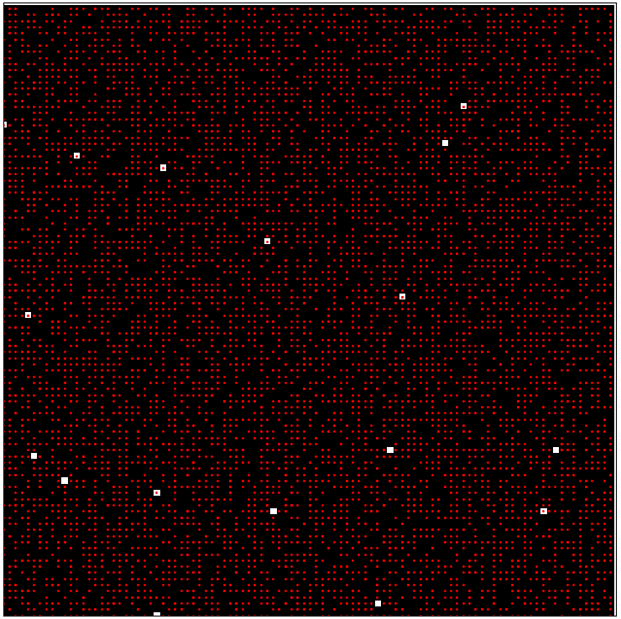
RANDOM SAMPLING EXAMPLES
Sampling occupancy map using order 4 randomized Hilbert Curve.
Sampling occupancy map using order 6 randomized Hilbert Curve.

Slide 7
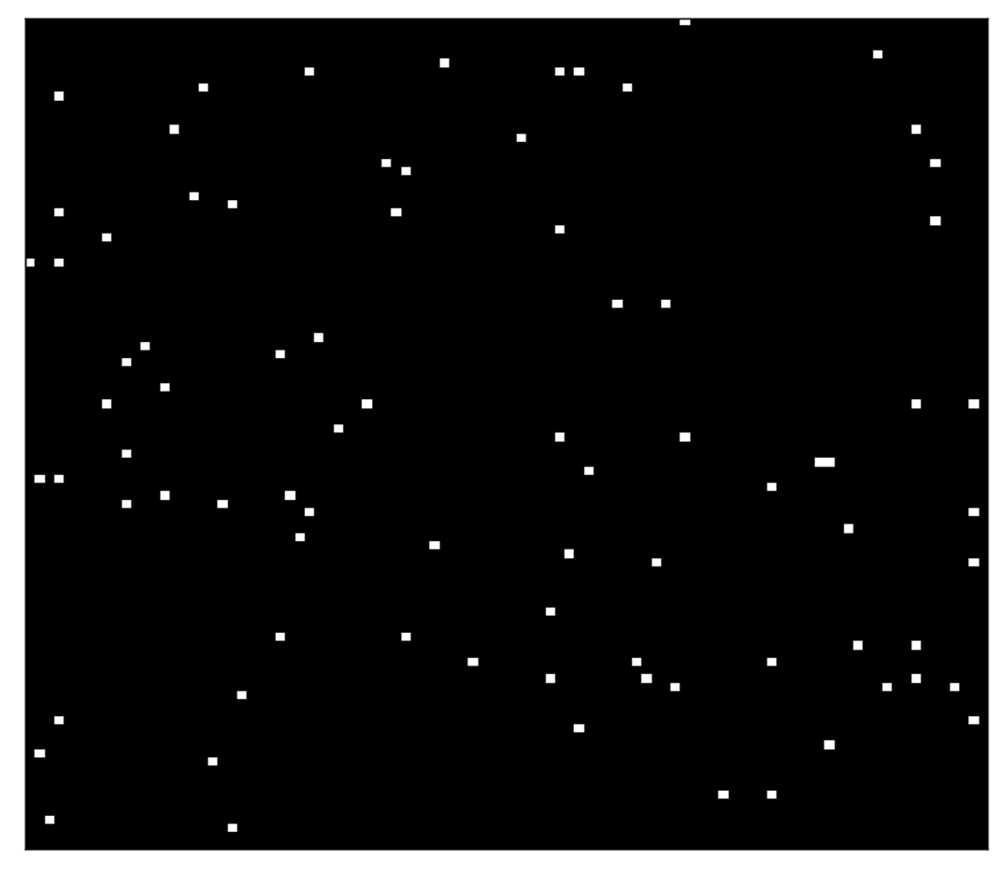
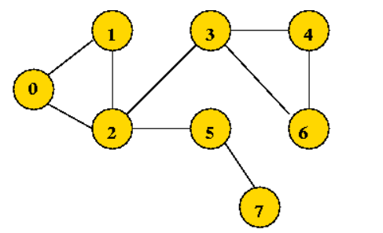
PRE-PROCESSING OCCUPANCY MAPS
Converting free space into a directed graph

Slide 8
GENERATING LABELS
To generate labels, we want to traverse the free space, black pixels, and count how many of the vertices of the randomized Hilbert curve are within the free space.
How do we prioritize vertices?
Essentially, we can build a viable path using only 75% of the vertices of the curve.
More specifically the vertices that fall in the quadrants containing the dotted line.
ThresholdVertices = 0.75*TotalVertices.
We’ll build on this concept of threshold vertices by generating a remaining- threshold-points-ratio that will determine when we have a solution.
Start
Goal

Slide 9
HILBERT CURVE EVALUATION ALGORITHM
totalVertices = length(verticesArray)
Threshold = 0.75*totalVertices
InitialThreshold = Threshold
For (vertex1,vertex2) in verticesArray:
If BOTH vertex1 and vertiex2 in freeSpaceGraph:
Threshold – BOTH
Elif only vertex1 or only vertex2 in freeSpaceGraph:
Threshold – ONE
remainingThreshold = Threshold
remainingThresholdRatio = (remainingThreshold/InitialThreshold)*100
if remainingThresholdRatio <= baselineThresholdRatio:
remainingThresholdRatio = min(remainingThresholdRatio, baselineThresholdRatio)
CONTINUE
else: VALID = currentOrder ;BREAK

Slide 10
DATASET
Training set : 31450 samples, 31450 labels
Testing set: 12450 samples, 12450 labels.
Both datasets are compressed NumPy arrays with 10,000 columns per row.
These columns are the 100*100 pixels of the occupancy map, flattened out before being stored.

Slide 11
THANK YOU
Lennox Apudo.

